Slide 1
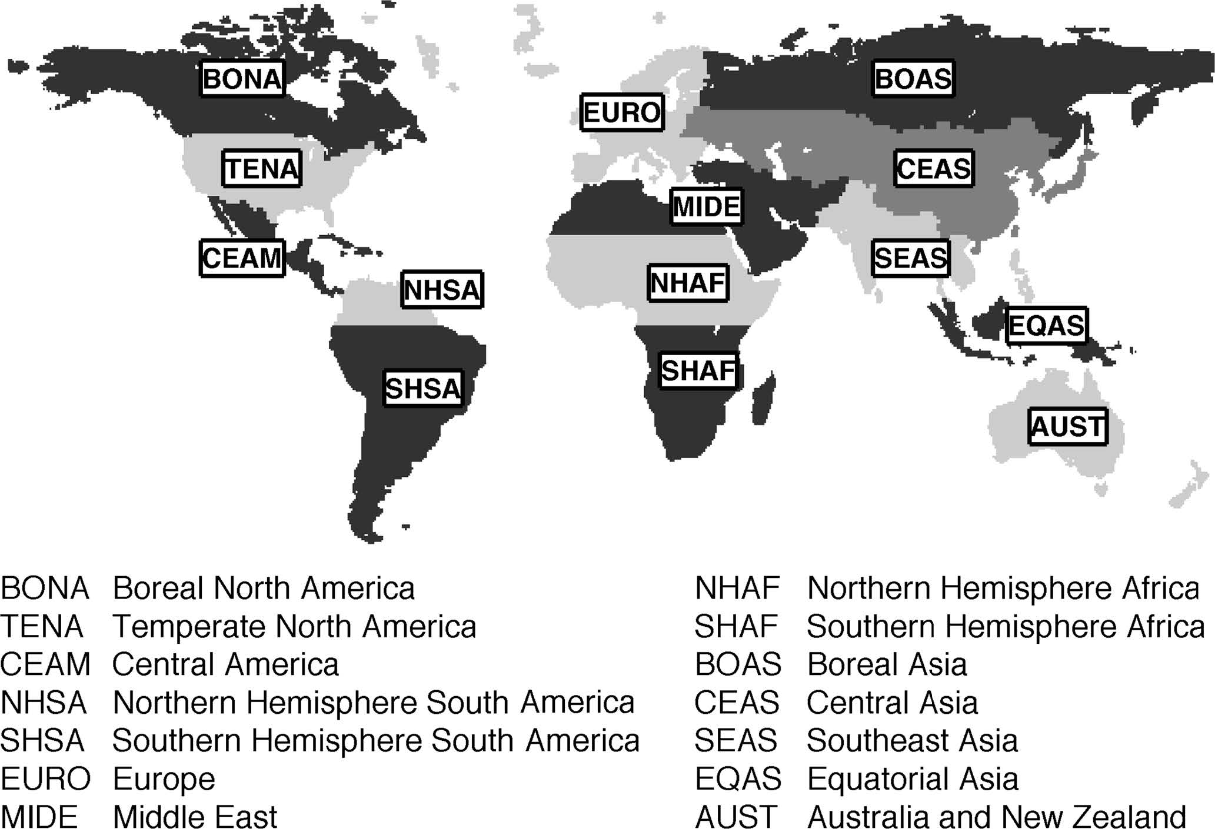
1:
2:
3:
4:
5:
6:
7:
8:
9:
10:
11:
12:
13:
14:

Slide 2
